Slide 1
Milestone 1
By: Eric, Sunny, Tim, Eddie, and Ketan

Slide 2
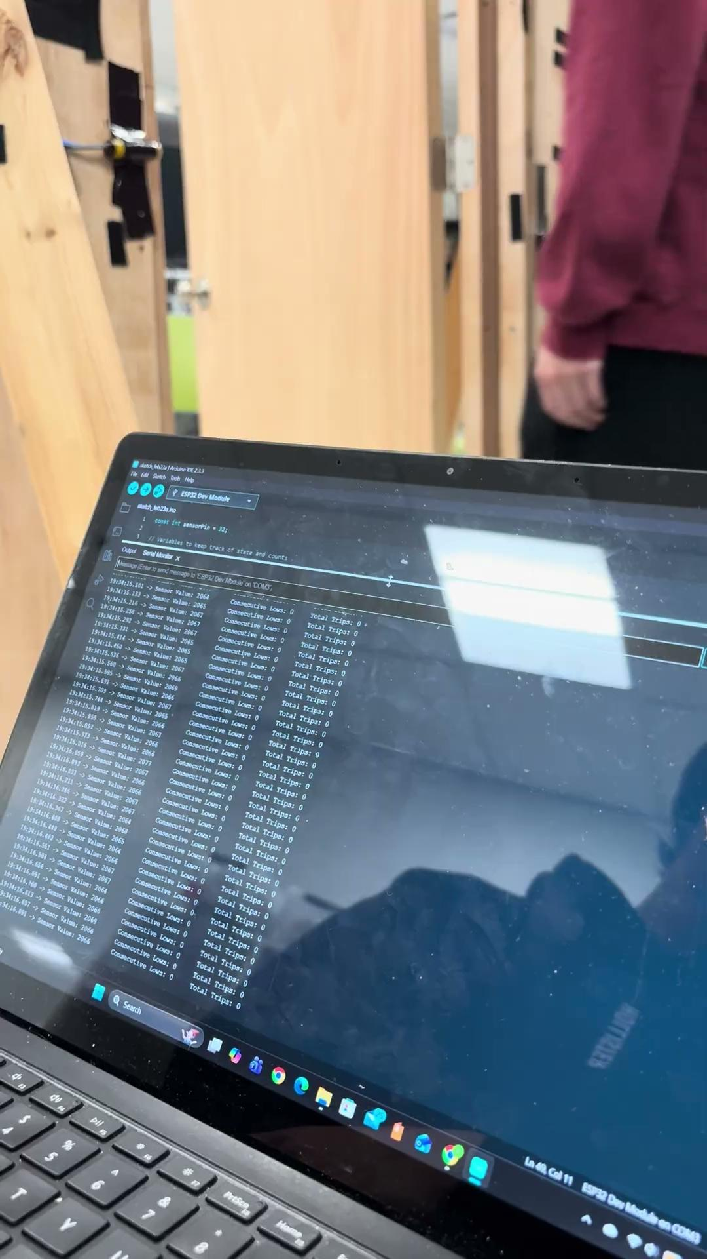
Experiment 1: Regular Walking
Sensor is able to detect a person walking through the door both ways
Software is incrementing the count by 1 only when the beam is broken, then unbroken.

Slide 3
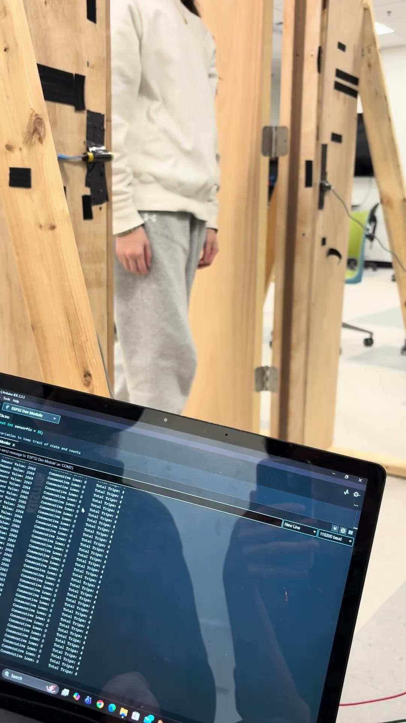
Experiment 2: Slow Walking
Sensor is able to detect a person walking through the door slowly without double counting

Slide 4
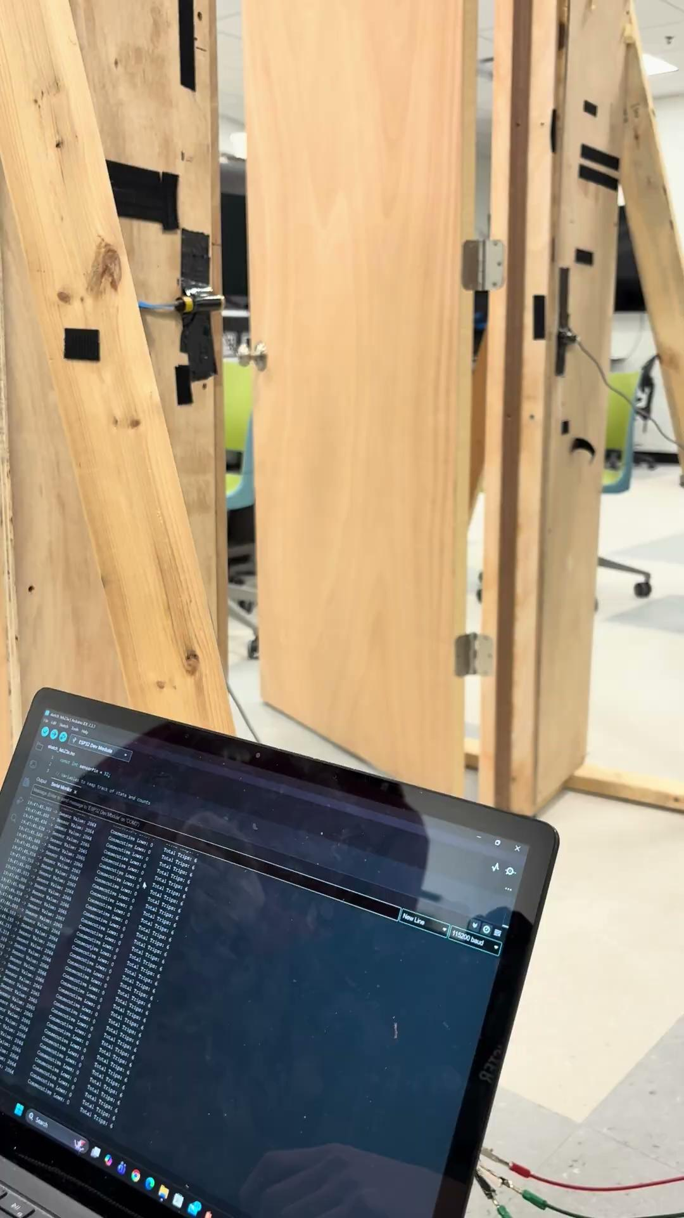
Experiment 3: Fast Walking
Sensor is able to detect a person walking through the door quickly without missing counts
Sampling time of the sensor ( 3 samples of 50 ms) is set optimally to account for fast speeds

Slide 5
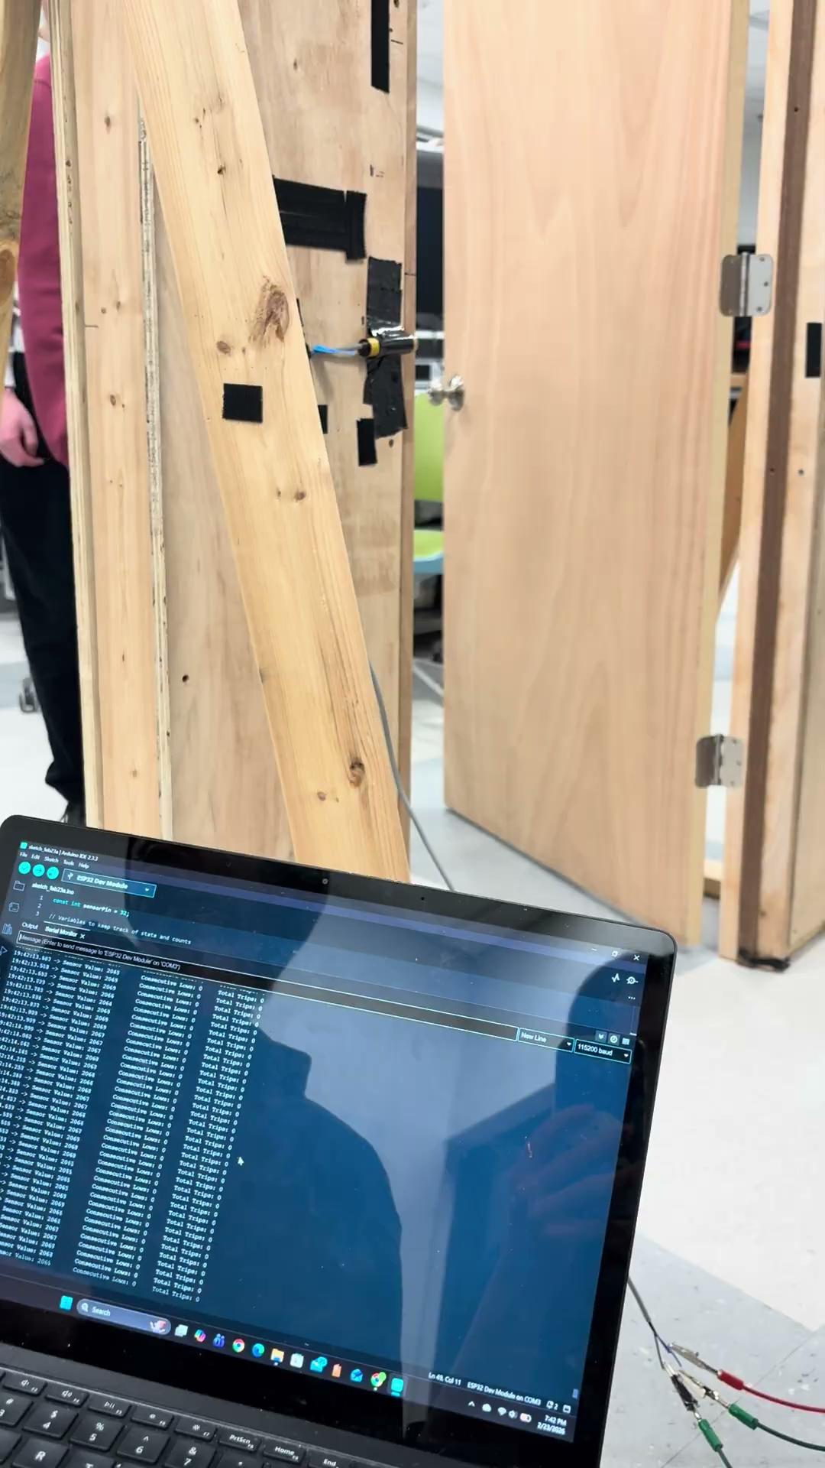
Experiment 4: Multiple People
Sensor is able to detect a stream of people walking through with tight gaps in between

Slide 6
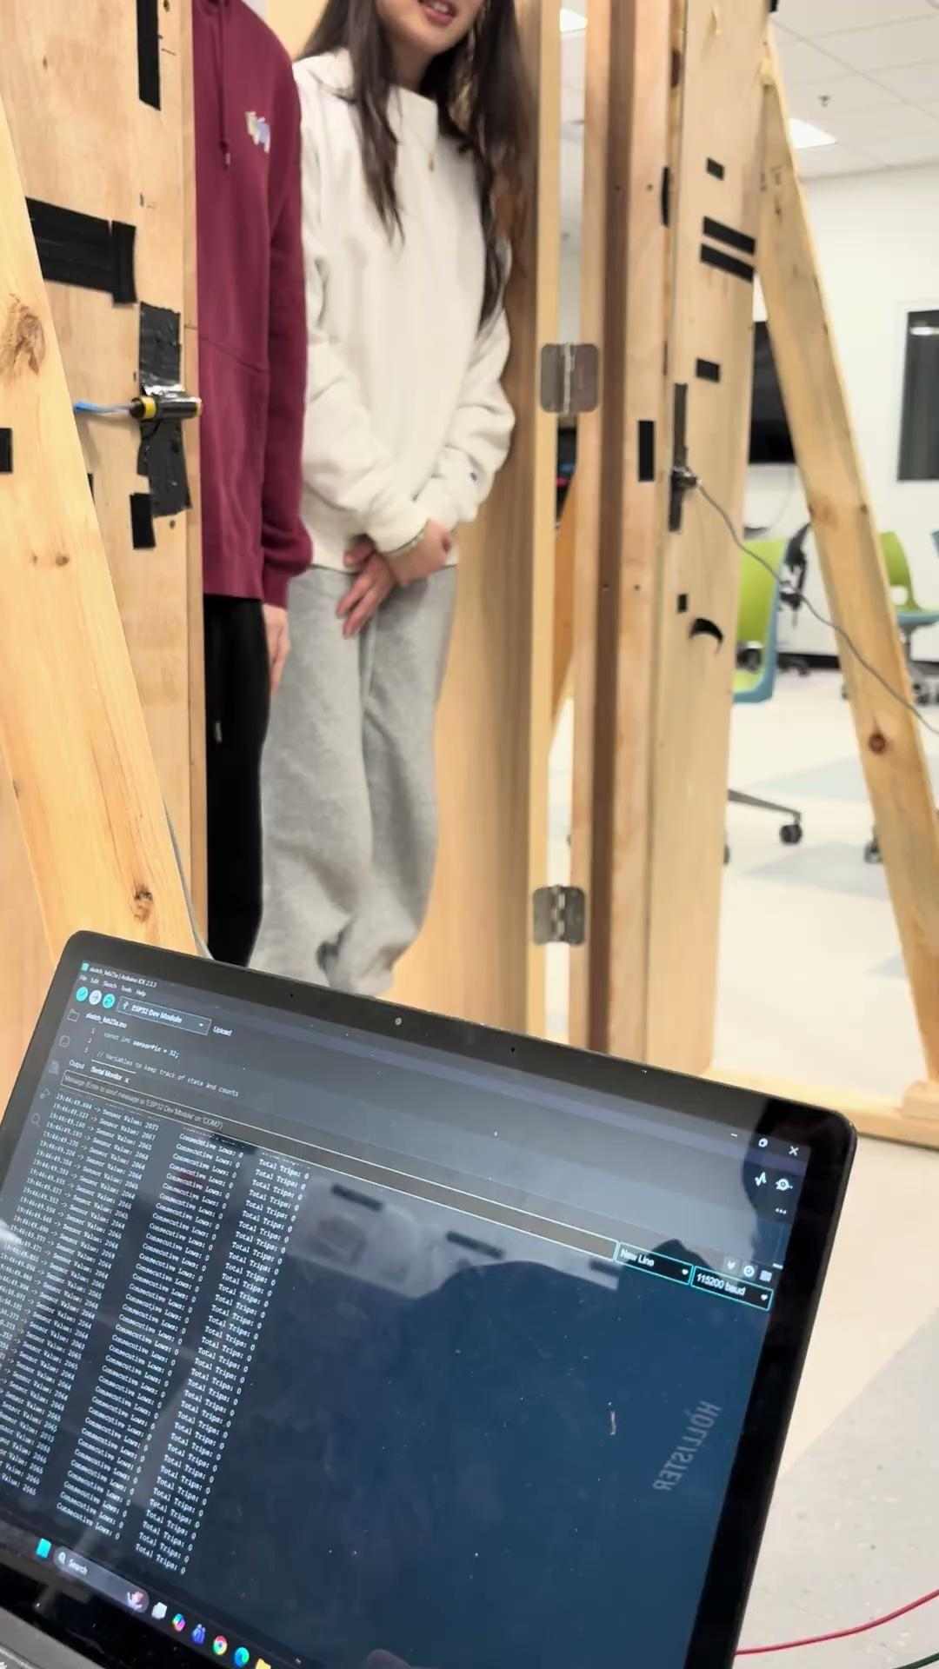
Experiment 5: Side by Side
Sensor is unable to detect two people entering simultaneously
The beam is broken only once, hence a single count

Slide 7
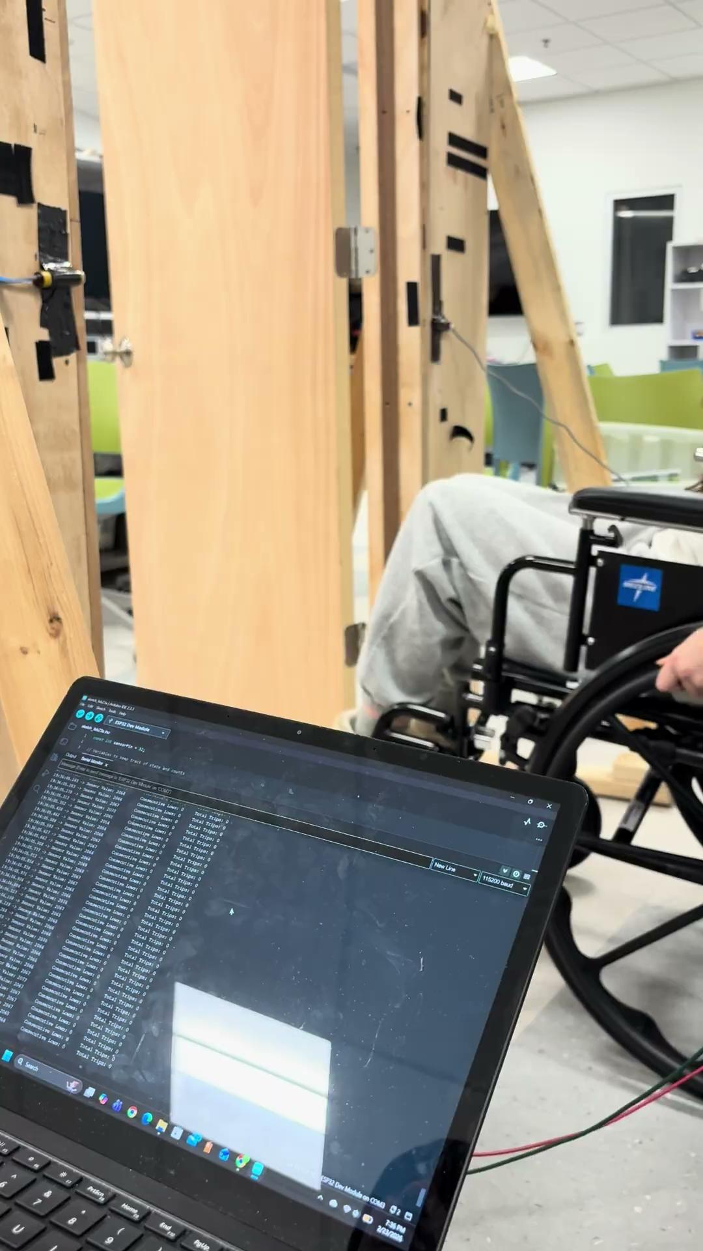
Experiment 6: Wheelchair
Sensor is able to detect a person in a wheelchair going through.
The sensor is set to a suitable height for people in wheelchairs.

Slide 8
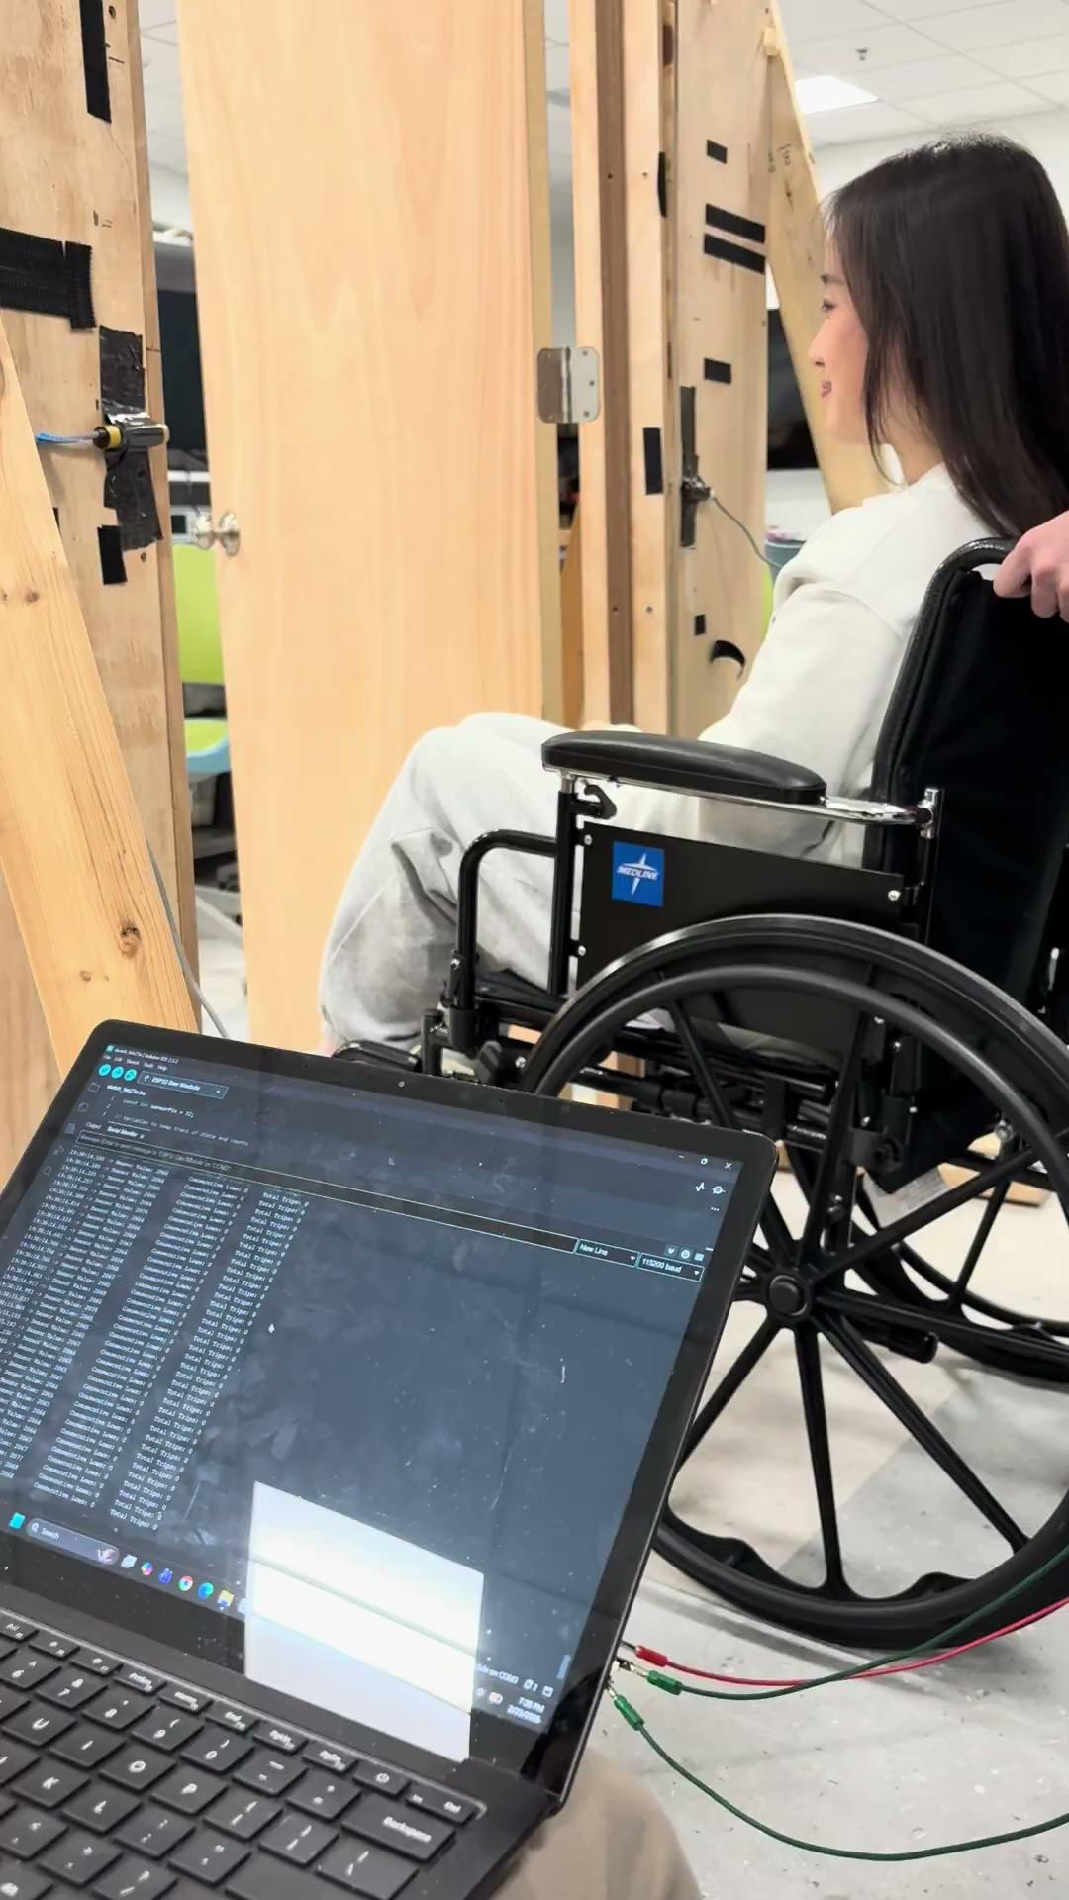
Experiment 7: Person and Wheelchair
Sensor is able to detect a person pushing a wheelchair as two people
The sensor is set to a suitable height that sees the gap in between the wheelchair and person pushing

Slide 9
Summary of Results
Passed: Regular Walking, Slow Walking, Fast Walking, Multiple People, Wheelchair, Person and Wheelchair
Failed: Side by Side (counted 1)
Next steps: Count people entering/exiting door

Slide 10
Mitigating Problems/Challenges
Add thermal sensor to detect edge cases (i.e. 2 people side by side)
Use two parallel tripwires to count people entering/exiting door
Do early testing for communication between sensors

